Slide 1
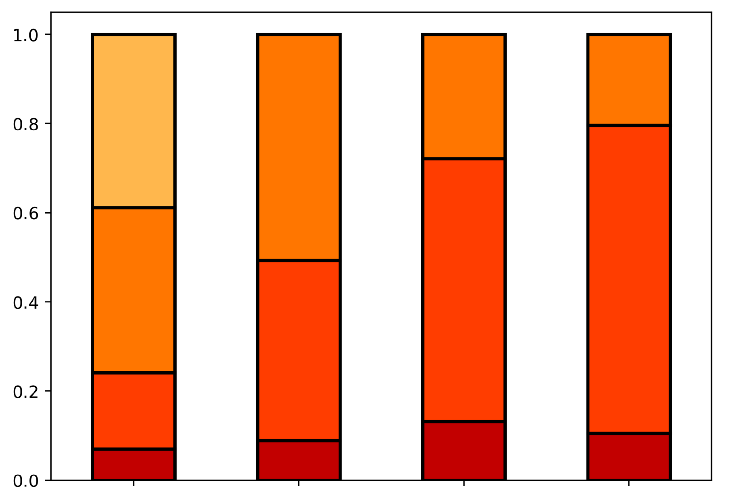
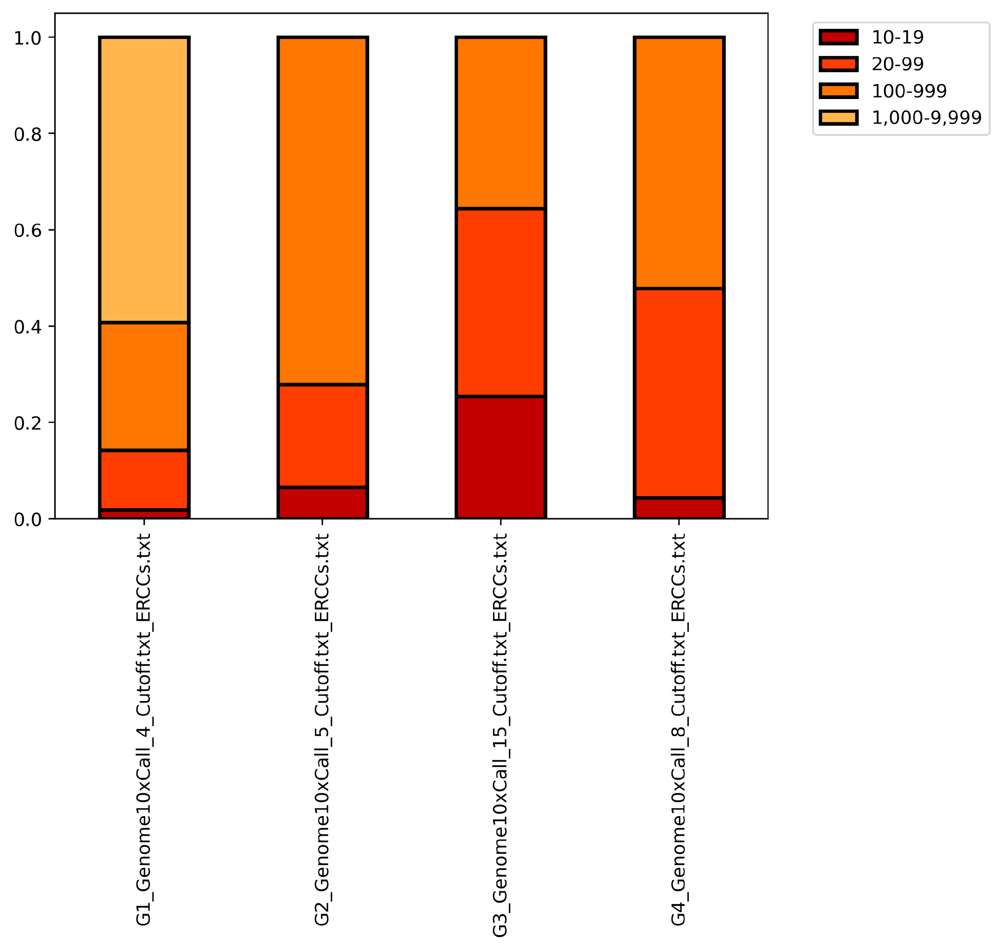
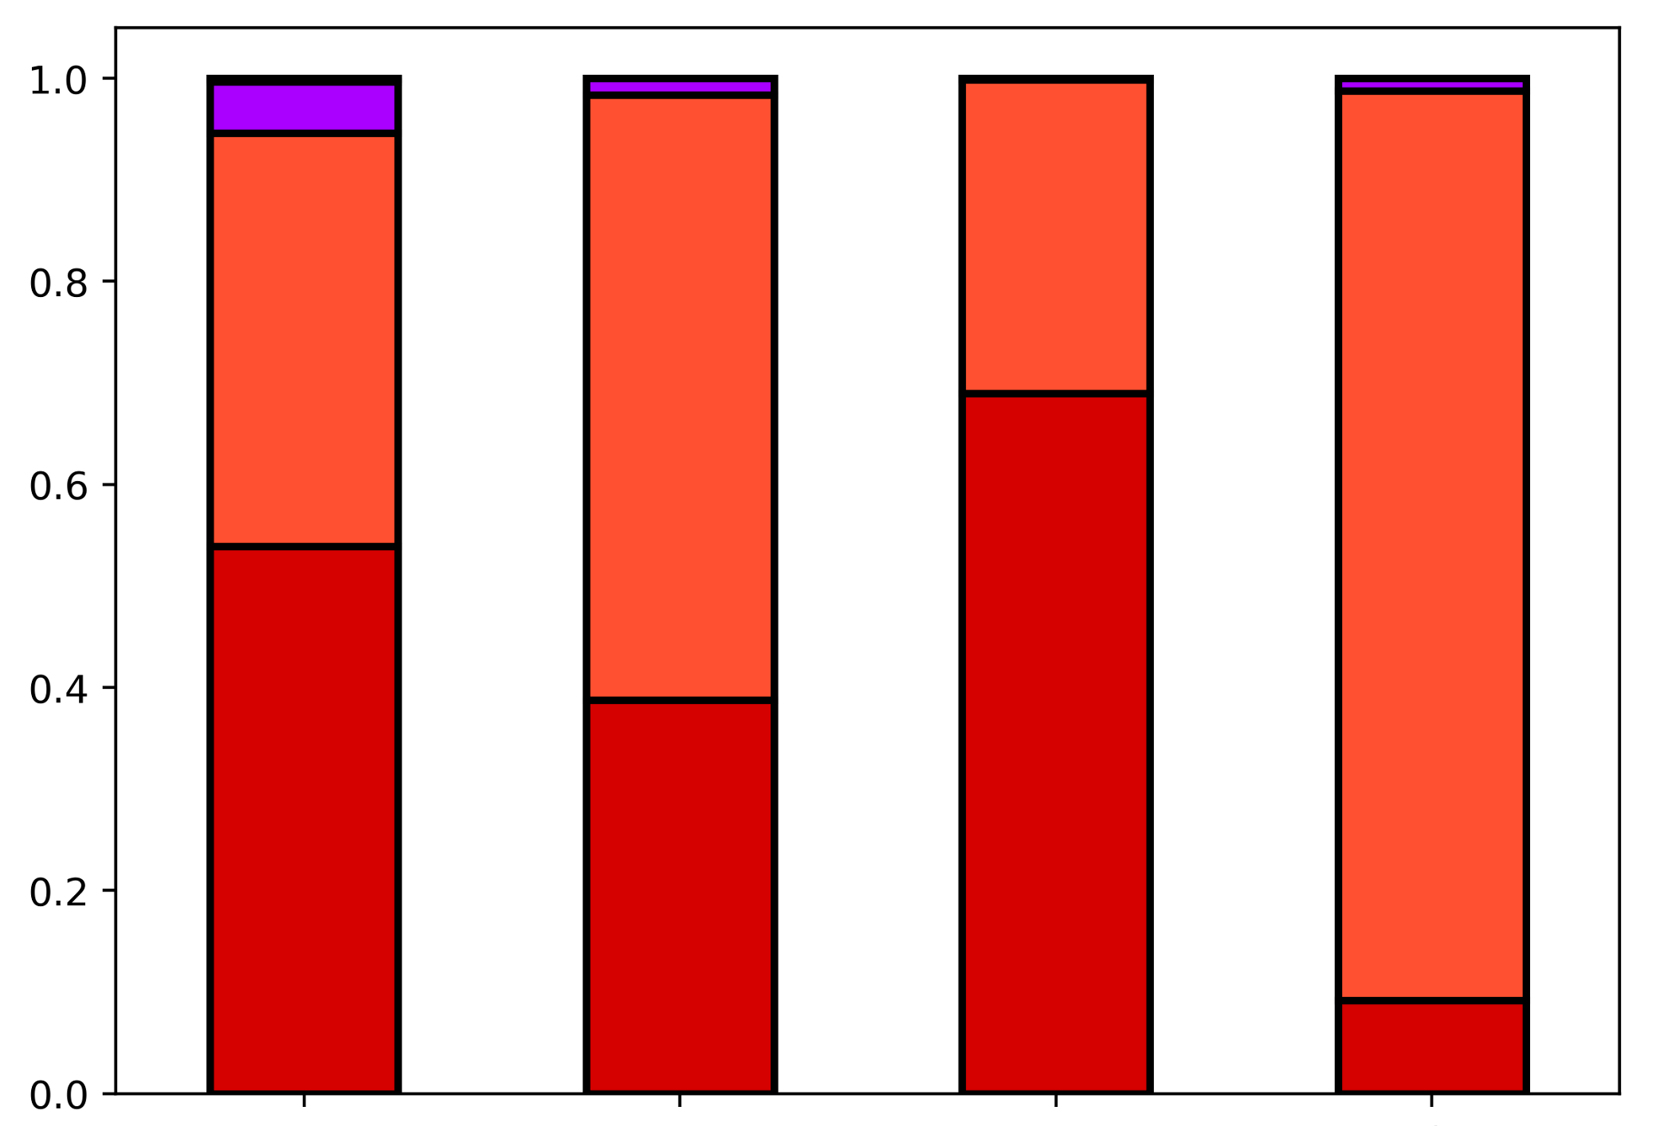
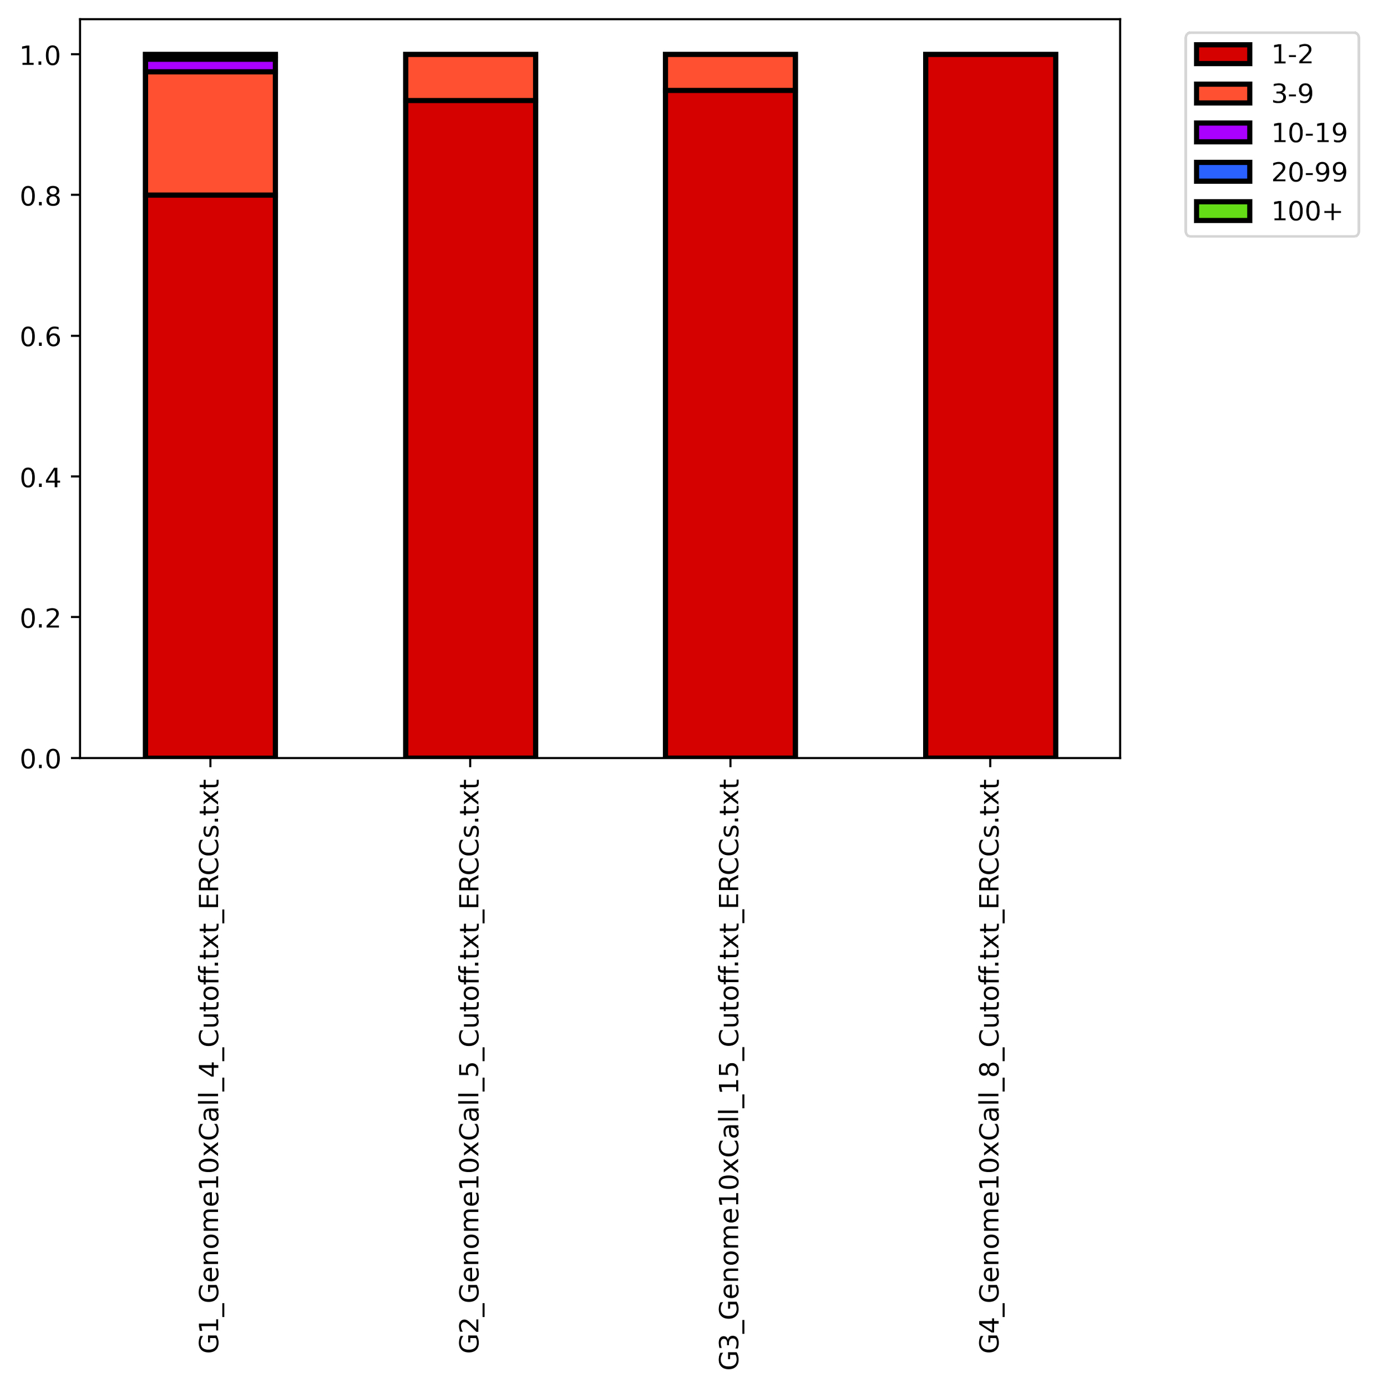
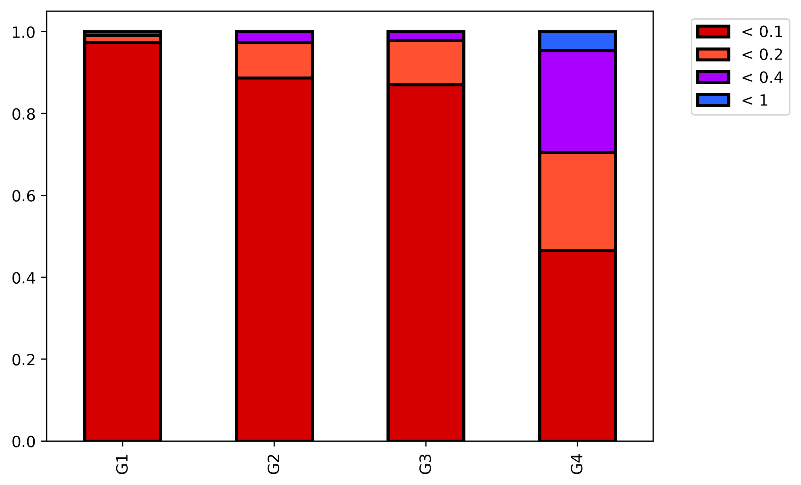
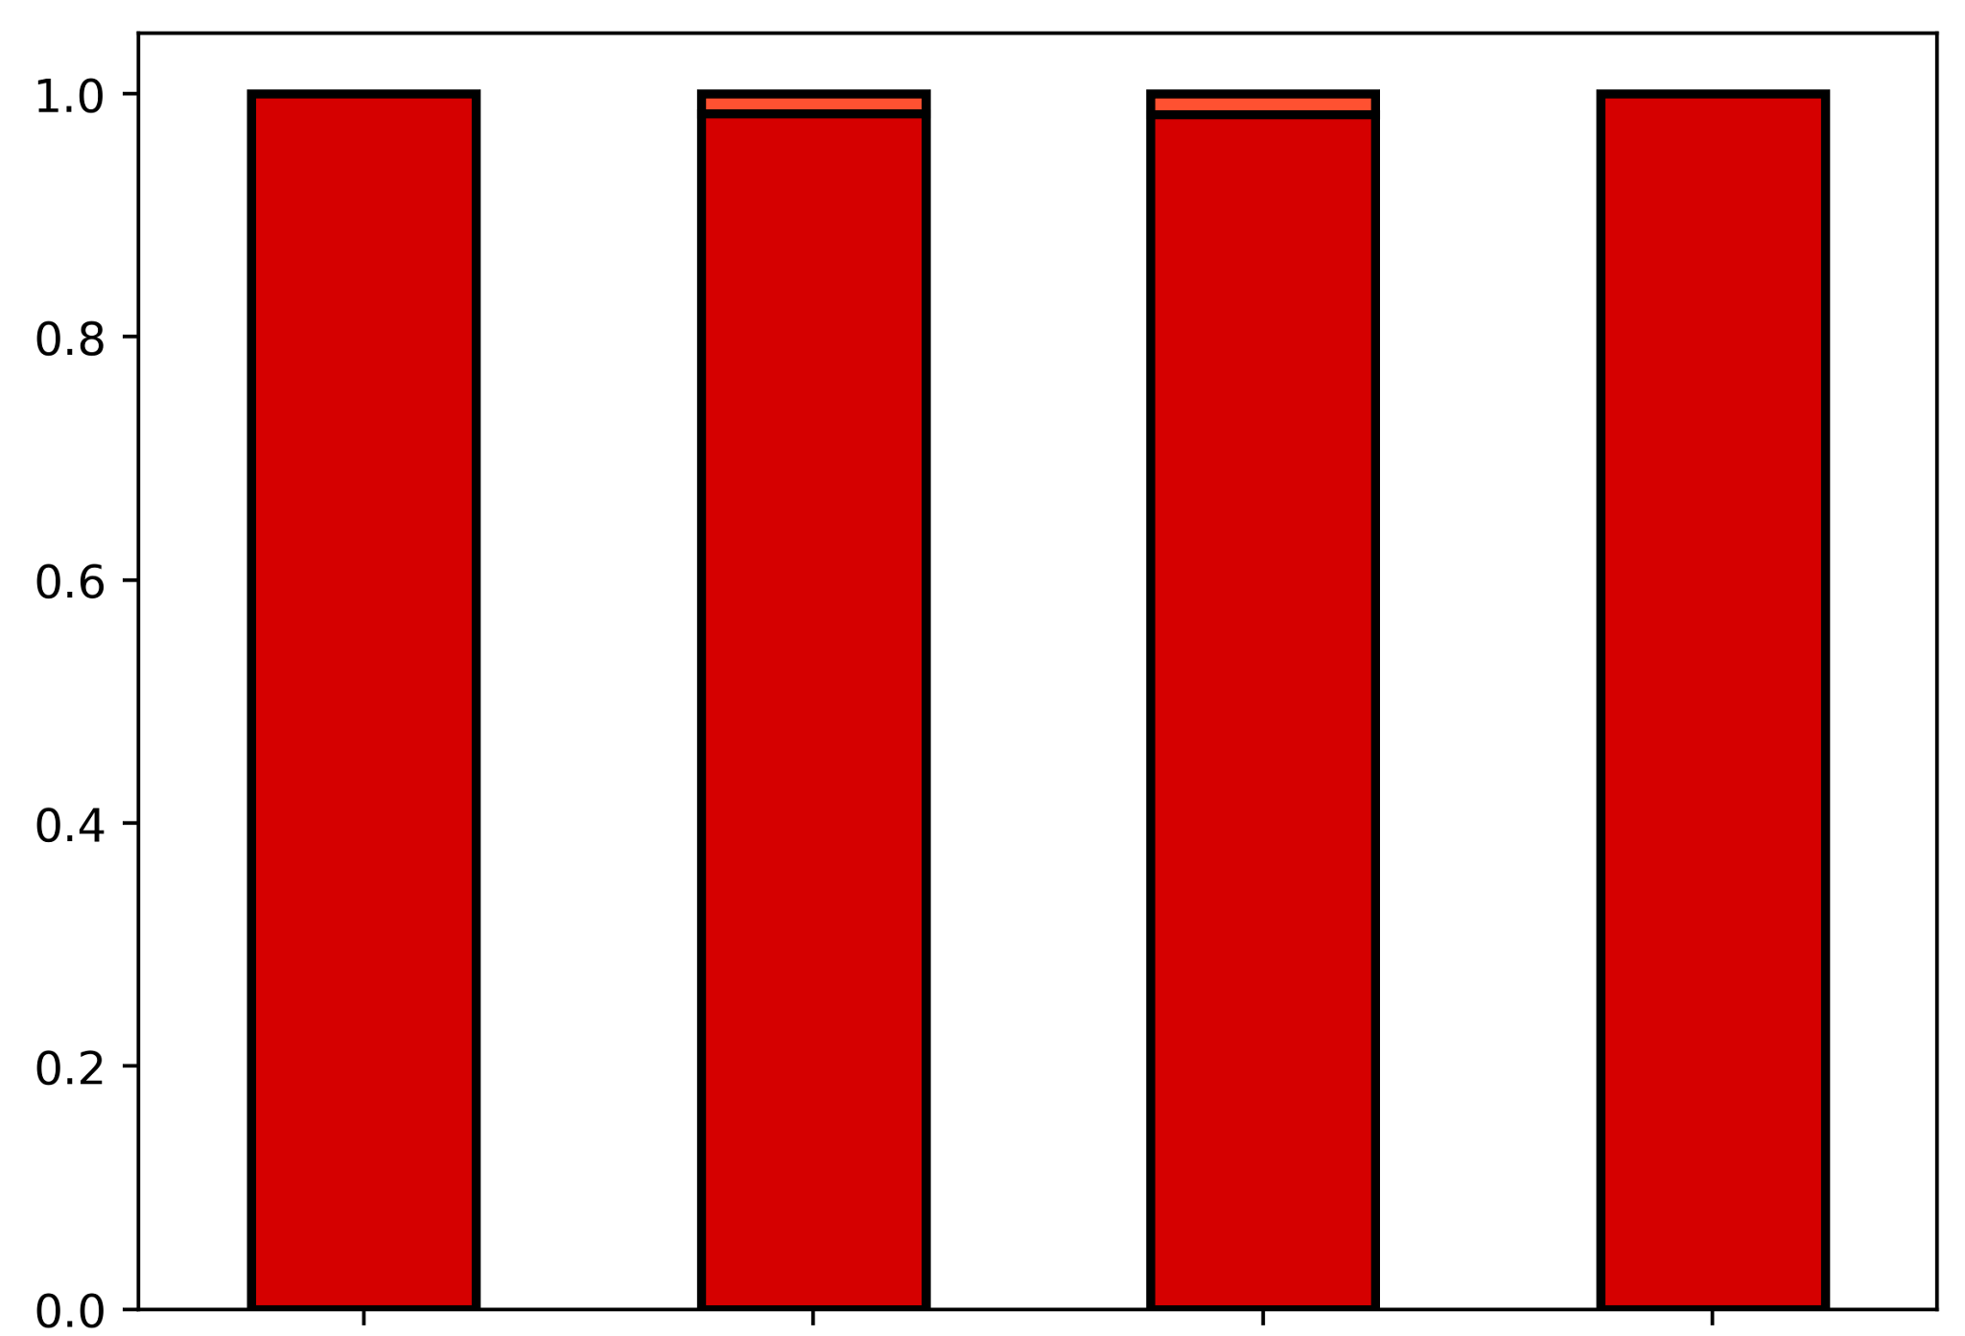
Before C-cutoff
After C-cutoff
Coverage at p-m⁵C site
Proportion of ERCC reads
MT-A
MT-B
MT-C
MT-D
MT-A
MT-B
MT-C
MT-D
Number of p-m⁵C per site
Proportion of ERCC reads
MT-A
MT-B
MT-C
MT-D
MT-A
MT-B
MT-C
MT-D
p-m⁵C non-conversion rate
Proportion of ERCC reads
MT-A
MT-B
MT-C
MT-D
MT-A
MT-B
MT-C
MT-D
Supplementary Figure 9. Read coverage, m⁵C artifact count, and m⁵C artifact ratio at ERCC positions. Values are binned according to the legend.
Notes:
(A) Read coverage and m5C artifact count at ERCC positions. Values are binned according to legend.

